Slide 1

IoT-Based Factory Monitoring and Control System

Slide 2
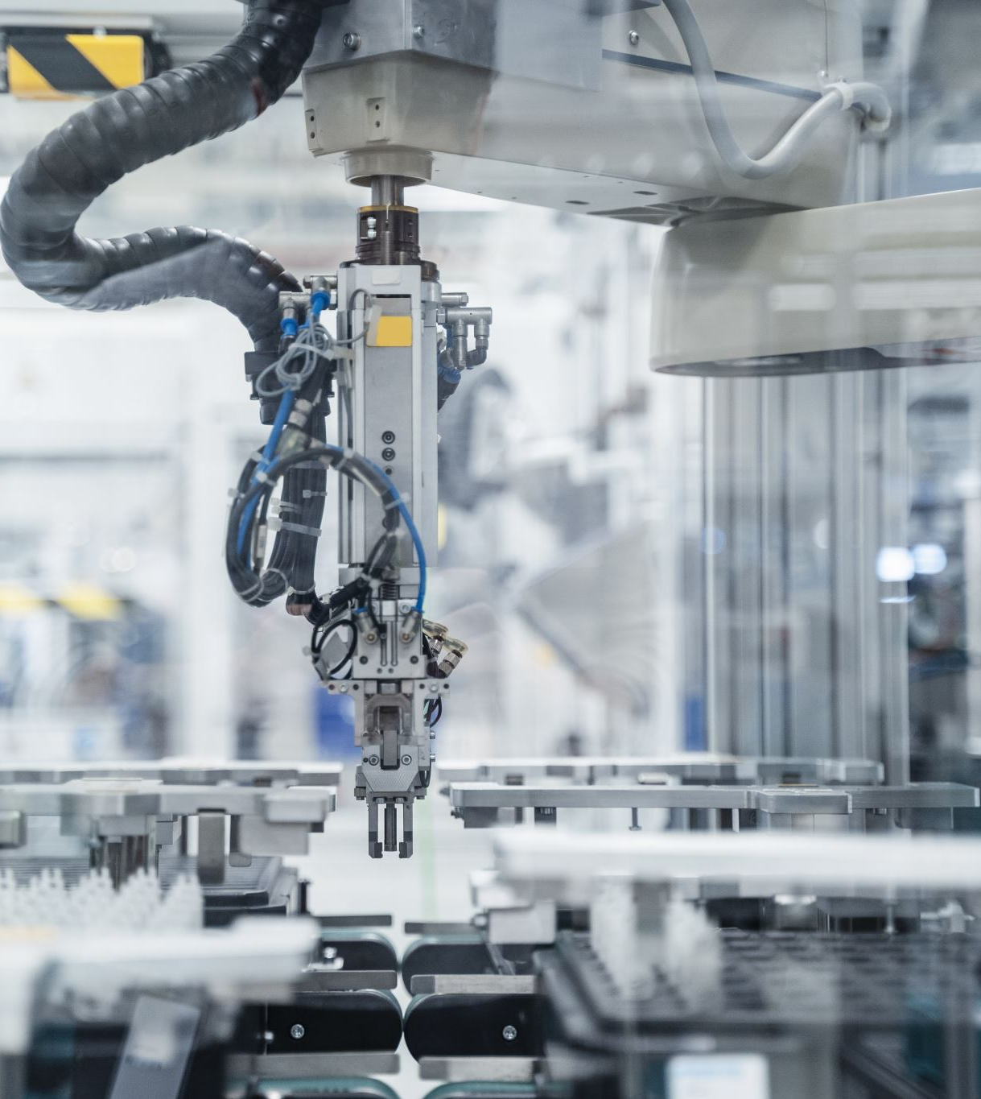
Introduction
Industrial automation uses advanced controls like PLCs, sensors, and drives for efficient monitoring and control, along with computing, communication, and HMI systems.
A network of 1000+ sensors and control variables is integrated with standalone computing systems, facilitating centralized control of industrial processes.
DCS (Distributed Control System):
A DCS is a control system used to operate and control entire industrial processes centrally.
It distributes control tasks across a network of controllers, making it suitable for large-scale industrial processes.
Typically includes multiple control units, communication networks, and interfaces for process monitoring and control.

Slide 3
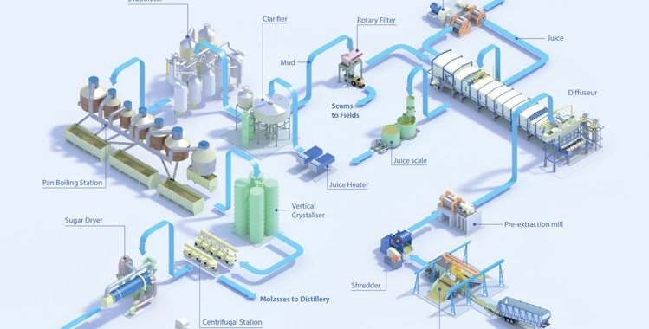
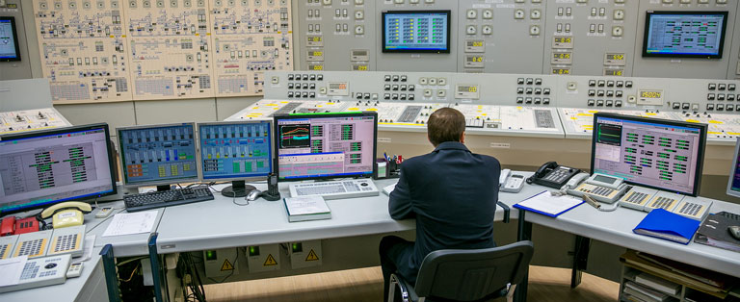
Data Security Concerns:
Problem: Unauthorized access to sensitive process data poses a significant security risk.
Impact: Breaches can lead to data manipulation, operational disruptions, or even compromise the safety of the industrial system.
Data Silos:
Problem: DCS systems may generate and store data in isolated silos, making it challenging to access and integrate information across the entire system.
Impact: Lack of data visibility can hinder comprehensive analysis and decision-making.
Limited Real-time Data Access:
Problem: Some DCS systems may face limitations in providing real-time access to critical process data.
Impact: Delays in accessing real-time data can impede timely decision-making and responsiveness to dynamic process changes.

Slide 4
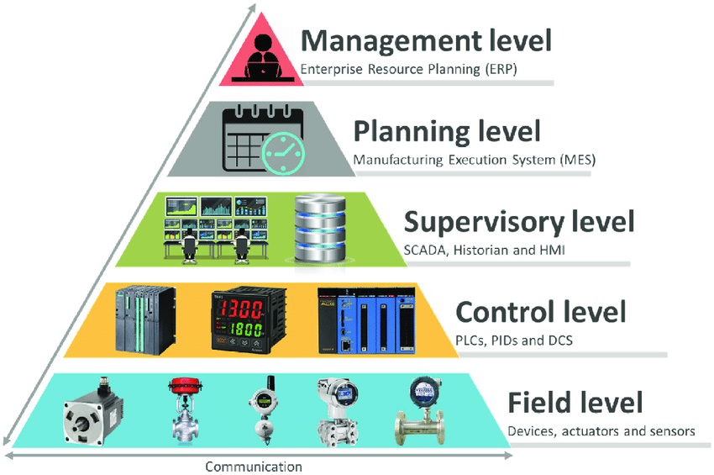
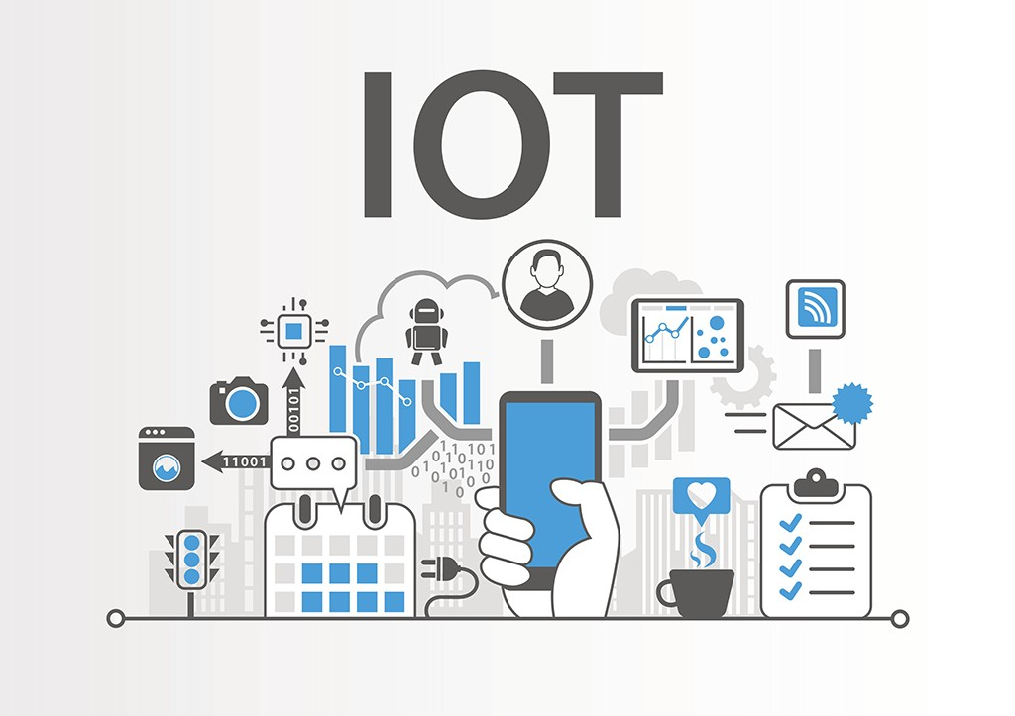
Project Objective
Leveraging IoT systems and platforms to Incorporating an Intermediate Real Time Data Sharing Layer.
Organization can streamline data processing, reduce latency, and empower faster, more informed decision-making across various industries and applications.
The implementation of IoT will enable swift transmission of crucial information to both emergency services and relevant stakeholders resulting in quicker response times.
IoT fosters collaboration among various departments, cultivating a more interconnected and cooperative workforce. Shared responsibilities enhance communication and problem-solving capabilities.
Delivery high visibility of the operation even away from control room.
This Photo by Unknown Author is licensed under CC BY-SA-NC

Slide 5
System Architecture
IoT Sensors
IoT Gateways
Cloud Server/AWS/Azure
Data Analysis
Automated Central Control
Alert/Notification System

Slide 6

Trade-offs
Balancing Automation Control with Manual Control for critical events.
Scalability Vs. complexity in IoT infrastructure.

Slide 7
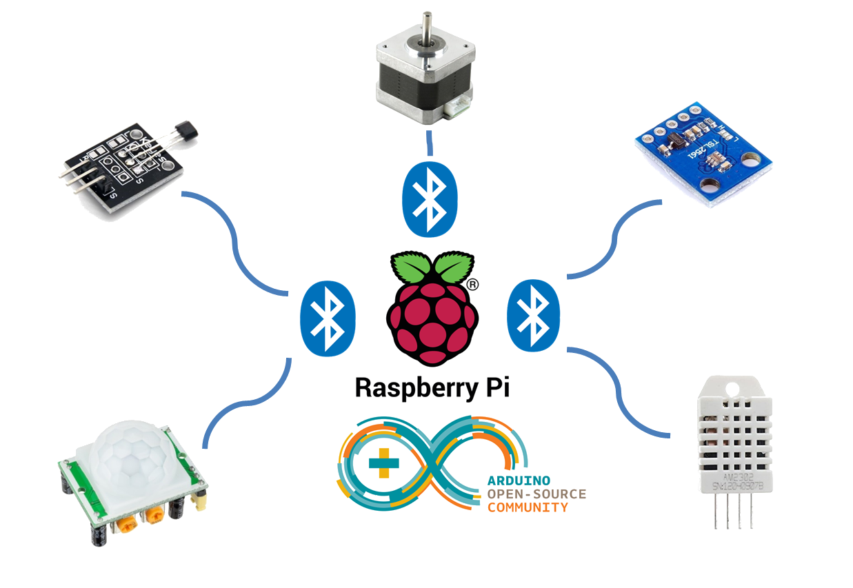
Technology Stack
Sensors –
Temperature, pressure, flow, vibration ETC.
IoT Gateway: MQTT
Cloud Platform - AWS
Alerting –
SMS / e-mail
Automated Control –
PLC,DCS
Manual Override Interface: web based

Slide 8
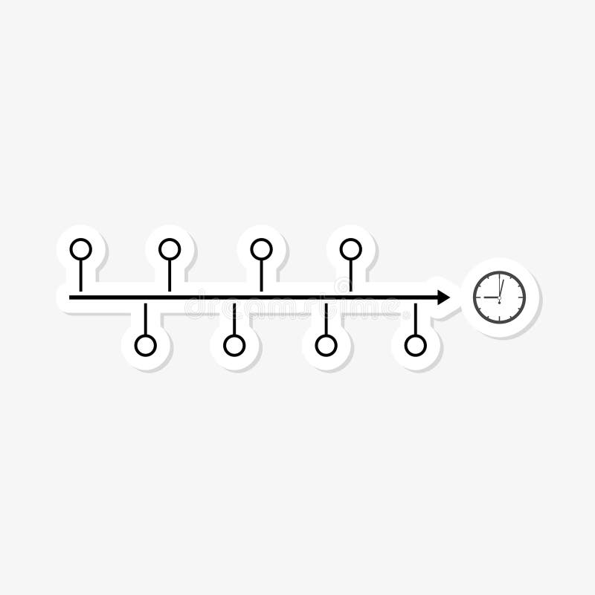
Timeline
Task 1: Hardware Setup
Task 2: Sensor Deployment
Task 3: IoT Communication Integration
Task 4: Cloud Platform Configuration
Task 5: Data Analysis and Control Logic Implementation

